Slide 1
CLIMATE ACTION

Slide 2
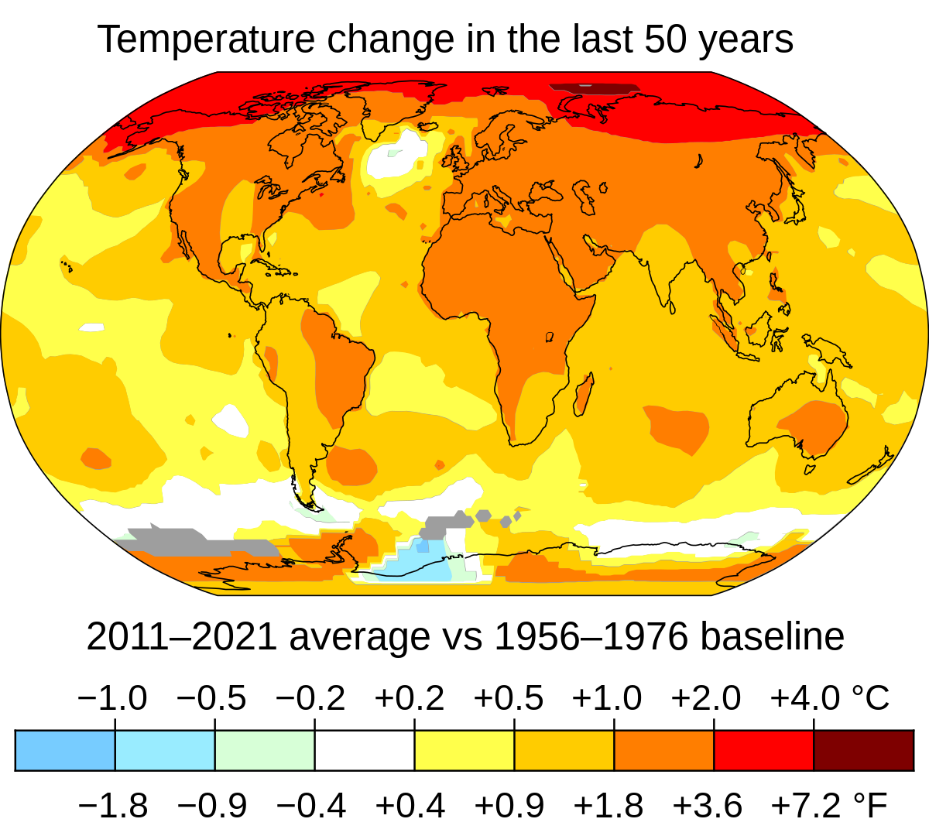
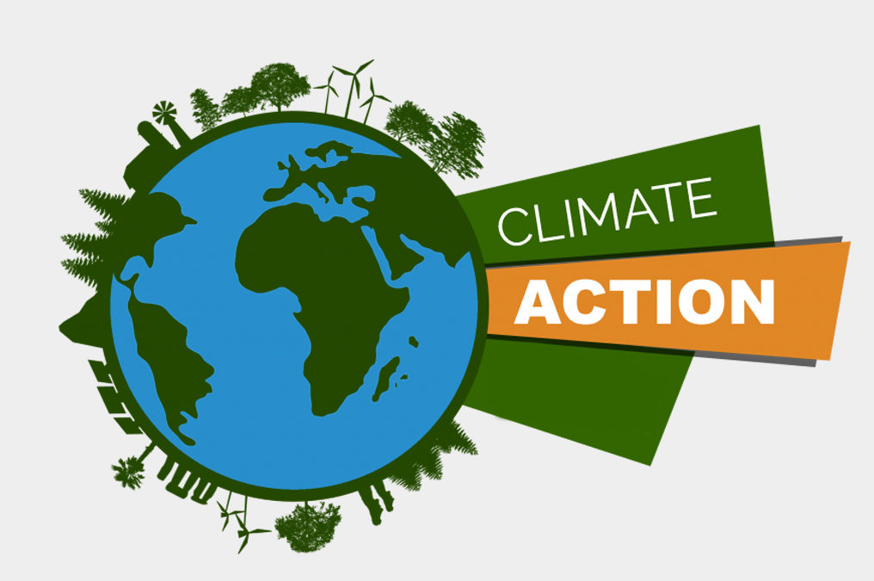
Research Background
● The rapid increase in the global warmth (un.org, 2023).
● Natural calamities caused by global warming
● Initiatives for the betterment of the environment (un.org., 2022)
Notes:
The global warmth has increased by 1.1 degree Celsius over the pre-industrial position and the level of the sea is also increasing with the liquidation of glaciers. Climate change also impacts the lives of the people with drought and flooding, pushing them into hunger and poverty, forbidding them from having access to basic necessities such as food, health and education and disputes. As per the United Nations' report, an approximate of 700 million people is going to have a risk of shifting by drought by the year 2030. However, several countries, industries and governments are getting aware of the fact of climate change and beginning to take action for the betterment of the environment. Private and public division investment requires increasing to US $1 trillion at least for this purpose by the year 2030.

Slide 3
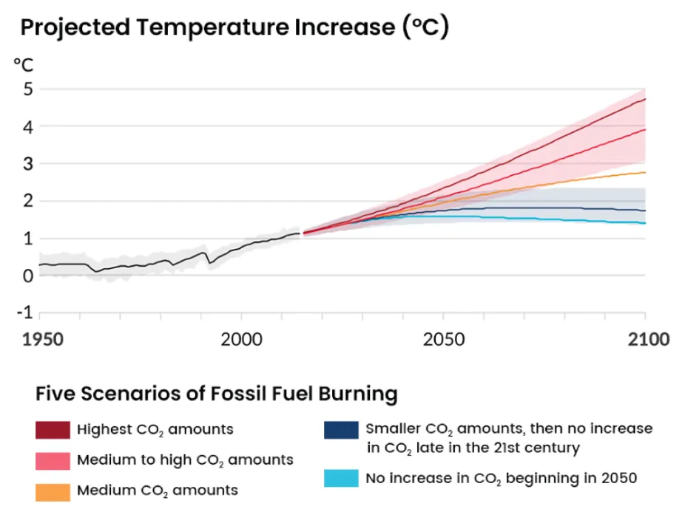
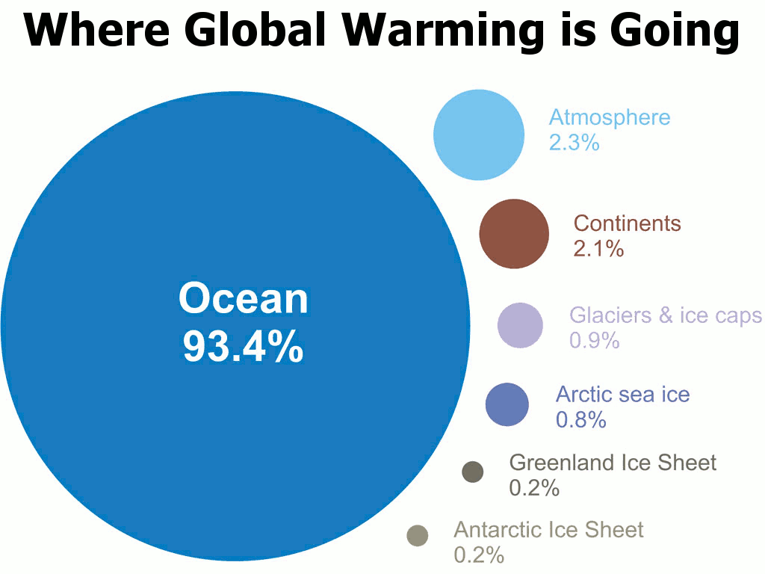
Research Aim and Objectives
Aim
To examine the impacts of climate change
Objectives
To evaluate the negative impacts of climate change on the world.
To assess the requirement of strengthening the means of revitalization and implementation partnerships for sustainable development.
To evaluate the mitigation initiatives by the governments

Slide 4
Research Questions
What are the negative impacts of climate change on the world?
What are the requirements for strengthening the means of revitalization and implementation partnerships for sustainable development?
What are the mitigation initiatives taken by the governments?

Slide 5
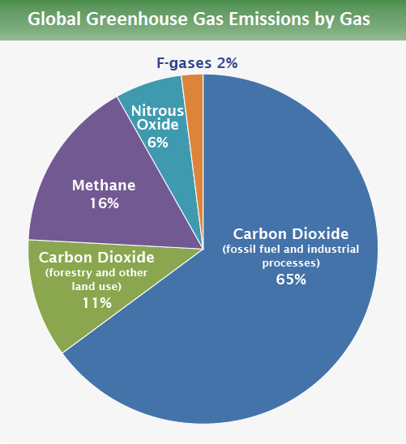
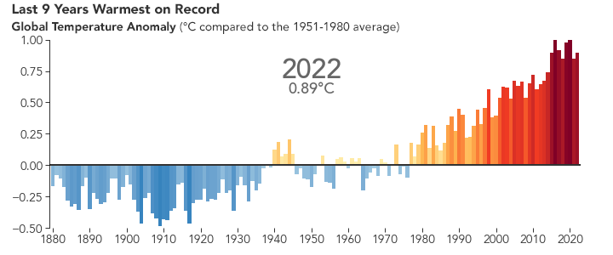
Research Rationale
● The increasing global temperature
● The increasing emissions of greenhouse gases by human activities (epa.gov, 2022)
● Human problems generated as an impact of global warming
Notes:
The increasing global temperature is the biggest issue in today's era. The temperature of the global climate is rising over the pre-industrial level which causes global warming. Climate change is basically a result of human activities and is becoming a danger to the future of this planet. The rapid increase in the level of global temperature will lead to human damages such as low economic growth, hunger and poverty, heat waves, food scarcity, low food production, tropical cyclones, river flooding, disputes, inaccessible basic necessities such as food, education and health, inequality and others. Carbon emission is another big reason for global warming. The level of carbon dioxide is increasing from the business sectors and industries. Over the years the carbon dioxide discharge is getting lower as a result of the necessary actions.

Slide 6
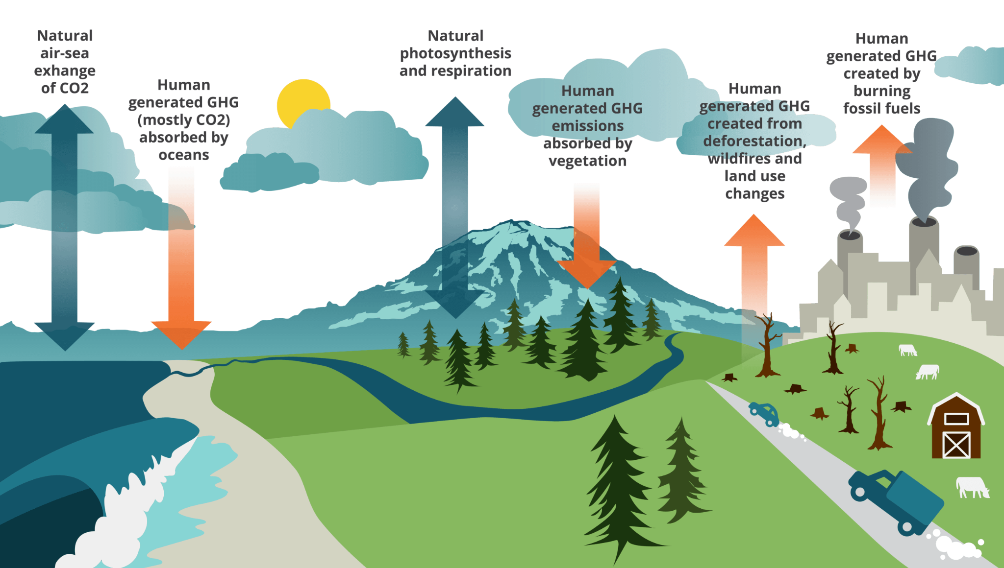
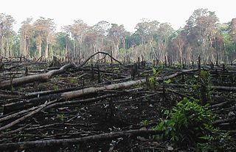
Literature review: Interference in the global climate
● This leads to damage to the climate system (un.org, 2023)
● Human interference
● Global climate change and governmental interference (Evans, 2019)
Notes:
As per the report of the United Nations Environment Program, Interference in the global temperature leads to damage to the climate system and it is a very critical task consisting of various levels. Human interference causes the atmosphere to lose its natural potential and impacts the daily lives of human beings. As opined by global climate change is a multidimensional process that gets inspired by human behaviour. The awareness is needed to be spread all over the world to regain the correct balance in the atmosphere. Some governmental interference is also needed to be done to take some initiatives in the process of climate change.

Slide 7

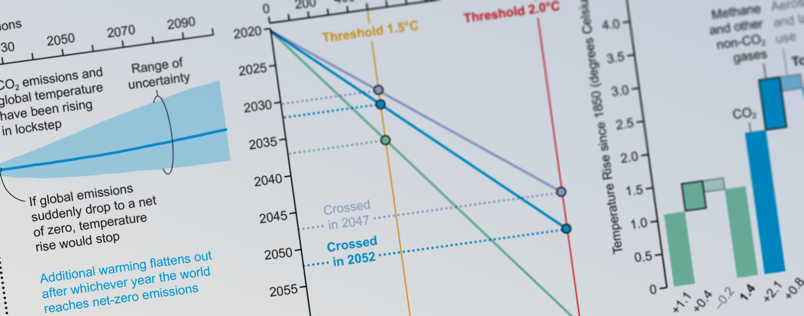
Literature review: Focus on global initiatives to reduce the negative impacts
● Global initiatives help to reduce negative impacts (Amankwah-Amoah, 2020)
● Discussion on the Earth Summit
● Low-intensity infrastructure (who.int, 2023)
Notes:
As per the scholarly article of, global initiatives can help to reduce the negative impacts of climate change on human lives. World health organisation leaders are taking specific measures to regain the balance of the environment. Again the earth summit should be conducted to discuss the measurements to take. As per the World Health Organisation, the change in the climate can cause approximate death of an additional 250,000 yearly by the year 2030. Again, places with low-intensity infrastructure in developing countries will face difficulties to manage the everlasting change in the climate. It is important for everybody to increase awareness regarding climate to prevent these damages in future.

Slide 8
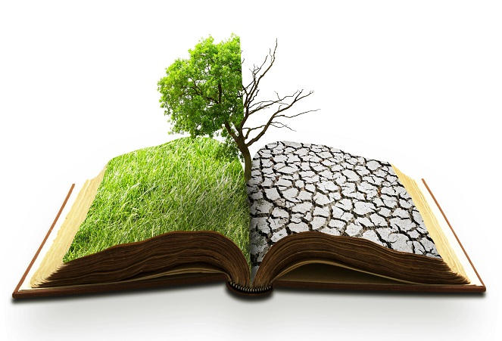
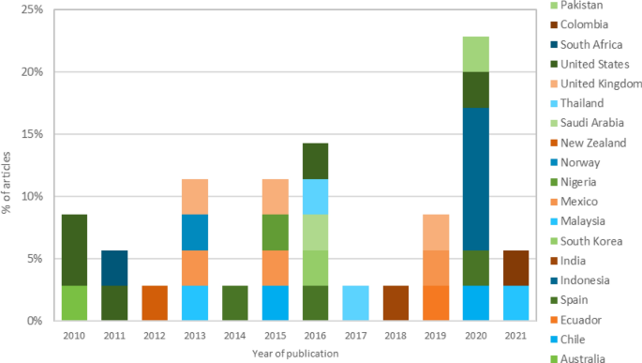
Past Literature
● Gradual increase in the change of climate
● Carbon emissions by the entertainment industry (Asante et al., 2021)
Notes:
Climate change is a gradually increasing problem with human activities and the increasing rate of carbon emissions. Carbon dioxide emission is increasing day by day for the industries and automobile industries. As opined by Carbon emissions from the entertainment industry and digital platforms are also responsible for the ever-increasing carbon dioxide rate in the atmosphere. 1 hour of streaming on digital platforms emits more carbon dioxide than traditional television. The level of global temperature is going to directly hit the lives of human beings. The damages caused by global warming can be prevented by the awareness and knowledge of climate change.

Slide 9
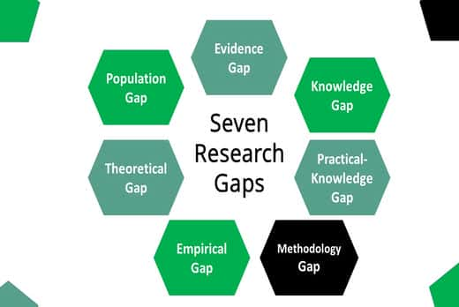

Literature Gap
Initiatives to control the negative impact
Partnership between the government and local citizens to prevent the impacts
Notes:
The research is generally based on the negative effects of climate change and the initiatives to be made to prevent the damage. To reach the goals it is important to have knowledge of climate change and the reasons behind it. Proper knowledge of the causes of the problem can lead to saving the damages from it and saving the climate. It is also important to have a partnership with the revolution and implementation process of the government initiatives and everybody should participate in it. Participation of each person can lead to the improvement of the global environment. Again, the research should go through the mitigation initiatives by the Government properly to know the real reason behind these initiatives and summarise the correct approach.

Slide 10
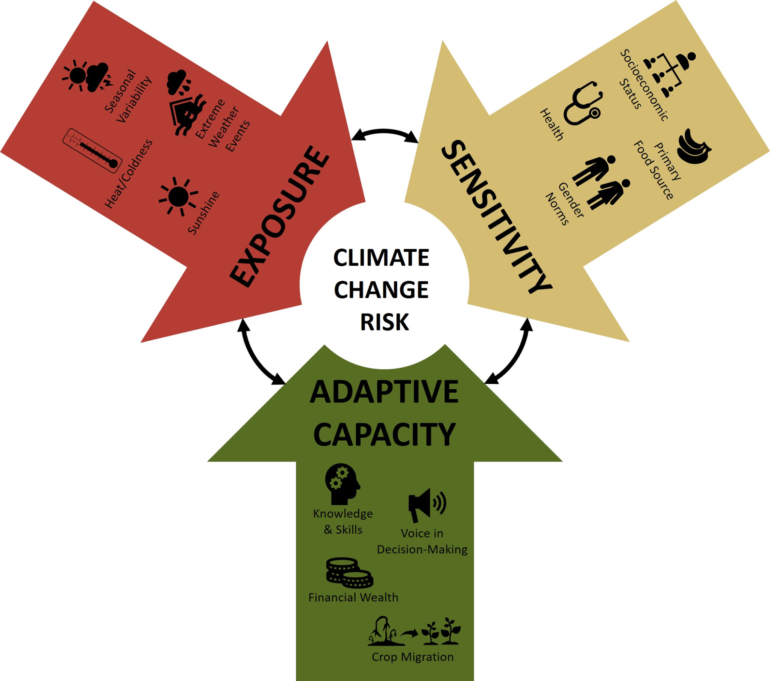
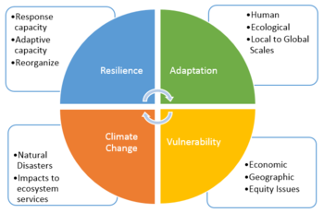
Theoretical Framework
● Global climate interference (Bran, 2020)
● The negative impact of climate change
Notes:
Global climate interference has negatively impacted the temperature of the environment. The rapid increase in the global temperature is the main cause of global warming which is parallelly connected with human activities and industries. The carbon emission from industries is also very much responsible for the global increasing temperature. The negative impact of climate change should be focused on to have proper control over the situation. Global initiatives should increase to have control over global climate imbalance. Also, there should be an increase in the initiatives by the local citizens as well as Governments.

Slide 11
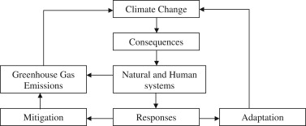
Conceptual Framework
Notes:
The concept of global climate refers to the condition of the global atmosphere that is needed to be safe to save the lives of human beings as it is strongly connected with the lives of humans The concept of greenhouse gas emission is also required to analyse to have a proper knowledge about the matter as well as initiatives should be taken.

Slide 12

Summery
Concept of climate change
Concept of human and government interference
Notes:
This chapter is an overall research on the climate change problem and the required initiatives of this problem. This chapter includes specific knowledge on the concept of interference on the global climate and the main concentration on the negative impacts of the issue. The chapter signifies the importance of the positive impacts of the global balance and overall analysis about the benefits of it. It also emphasises the global initiatives by the governments to control the situation and empower the knowledge of a clean environment.
This chapter also disclosed the theories and concepts of several writers about the global environment and its initiatives. The theories are generally based on the discussion of the authors. It also gives a conceptual framework about the overall condition of the environment and the need for its betterment. The chapter will also shed light on the researches of different writers to have clarity on the negative and positive effects of climate change.

Slide 13
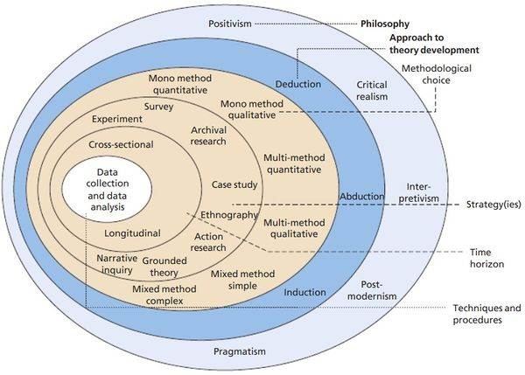
Methodology: Research Philosophy
Interpretivism philosophy
Primary data
Notes:
The research on global climate change and its initiatives will be designed as per the interpretivism philosophy. The result of this ideology will come through the assumption of real information based on the research and primary data sourced from governmental sites and the details on carbon emission details. The information in this research paper will come from the data based on the environmental report.

Slide 14
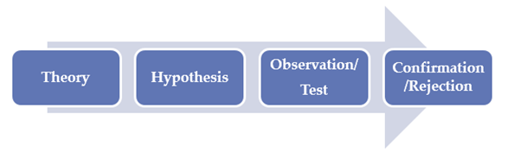
Methodology: Research Approach
● Deductive approach (Pandey, 2018)
● Quantitative information
Notes:
The leaders of the conferences of the United Nations will be informative for the sections of this research. A deductive research approach will be utilised to gather proper data for this research. The said approach can assist the researchers to analyse different factors of the research paper and it will also help the researchers to go through quantitative information in the research paper. The research paper will work on the process with the quantitative information gathered by the deductive approach to get real-time data.

Slide 15


Methodology: Research Design
● Explorative design (Pearse, 2019)
Notes:
An explorative research design will be utilised in this research to get clear data regarding the concept of a clear environment. The design has been chosen as it is effective for the particular research which does not have any previous records. The information about climate change will be gathered through the exploration of various aspects which are unstructured and informal. The explorative approach will be designed to get theoretical information on the reason for the change in the global environment. It will help to get ample unstructured information to get clarity about the fact of climate change.

Slide 16
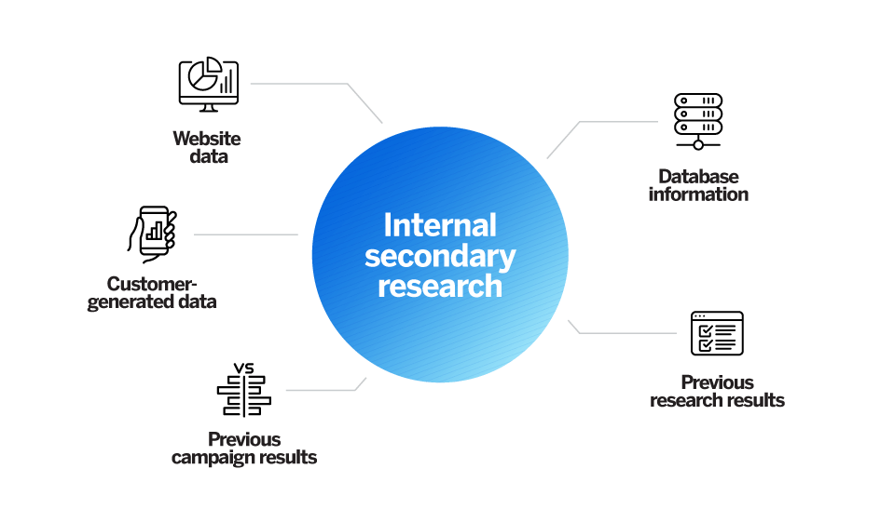
Methodology: Data Collection Method
● Secondary qualitative method (Belotto, 2018)
● Scholarly theories
Notes:
A secondary qualitative approach has been chosen to collect the relevant data about global climate change. The required information for this research paper has been collected from the scholarly theories of different authors and researchers as well as other data collection options such as authentic websites of the United Nations and World Health Organisation, Wiley, sciencedirect and many others.

Slide 17
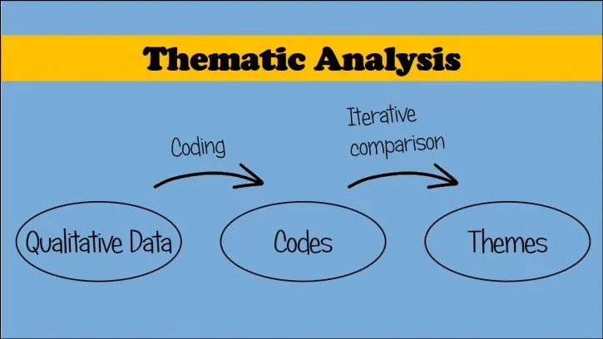
Methodology: Data Analysis
● Thematic data analysis method
● Articles, journals and e-newspapers (Castleberry and Nolen, 2018)
Notes:
Thematic data analysis method has been chosen for the purpose of analysing the information of this research paper which method depends on the qualitative theoretical information based on the articles. The analytical data for this research paper has been collected from different articles by various authors, e-newspapers, journals, research articles and many others. The articles have been chosen as per the requirement in this research paper.

Slide 18
Methodology: Data Sampling
● Exclusion and inclusion criteria (Hunter et al., 2019)
● Based on the industrial criteria
Notes:
The sample information for this research paper has been collected as per the exclusion and inclusion criteria. The inclusion condition of this paper is based on the quantitative details of the carbon emission and carbon dioxide emissions from the industrial areas and automobile industries. Again, the exclusion condition of this research paper is based on the negative impacts of climate change and the climate details as per the reports of the United Nations.

Slide 19
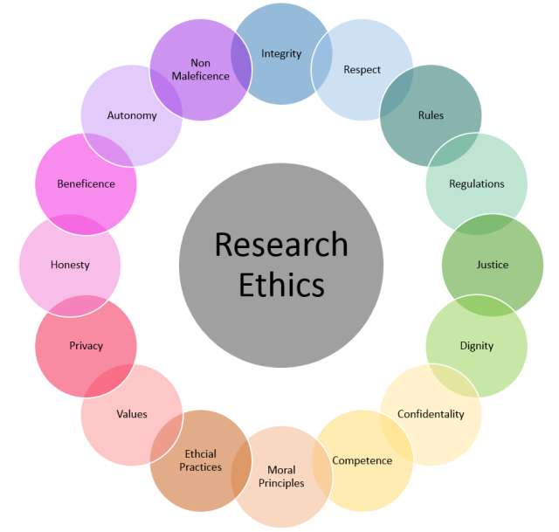
Ethical considerations
Not manipulated by any condition
Different factors of the research
Notes:
The complete information gathered for this paper has not been influenced by any factors throughout the process. This chapter of this research paper includes the factors for analysing the process through qualitative and quantitative information. It defines different aspects of completing the data which includes research philosophy where interpretivism philosophy has been chosen. Again, the Deductive approach and explorative design have been chosen to get the details of the research information. Thematic data analysis method has been chosen to get the details about the quantitative data on the basis of exclusion and inclusion criteria where industrial records and the reports of the United nation have been chosen to enclose the required data of this research paper. The industrial data has been gathered from the carbon dioxide, methane and greenhouse gas emission levels of the respective sectors and the reports have been collected from the original source of the United Nations.

Slide 20
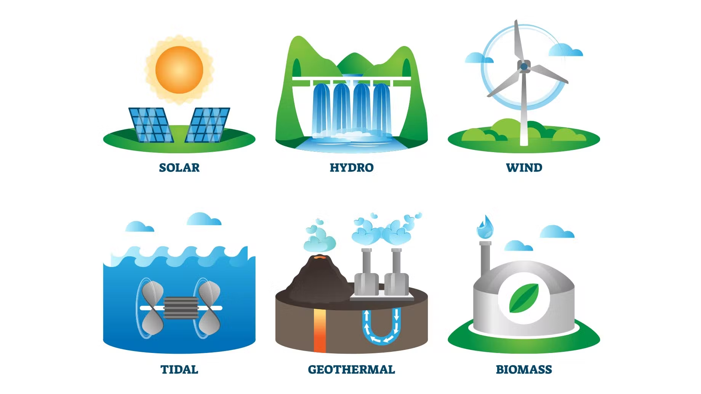
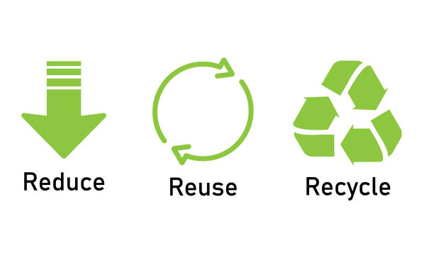
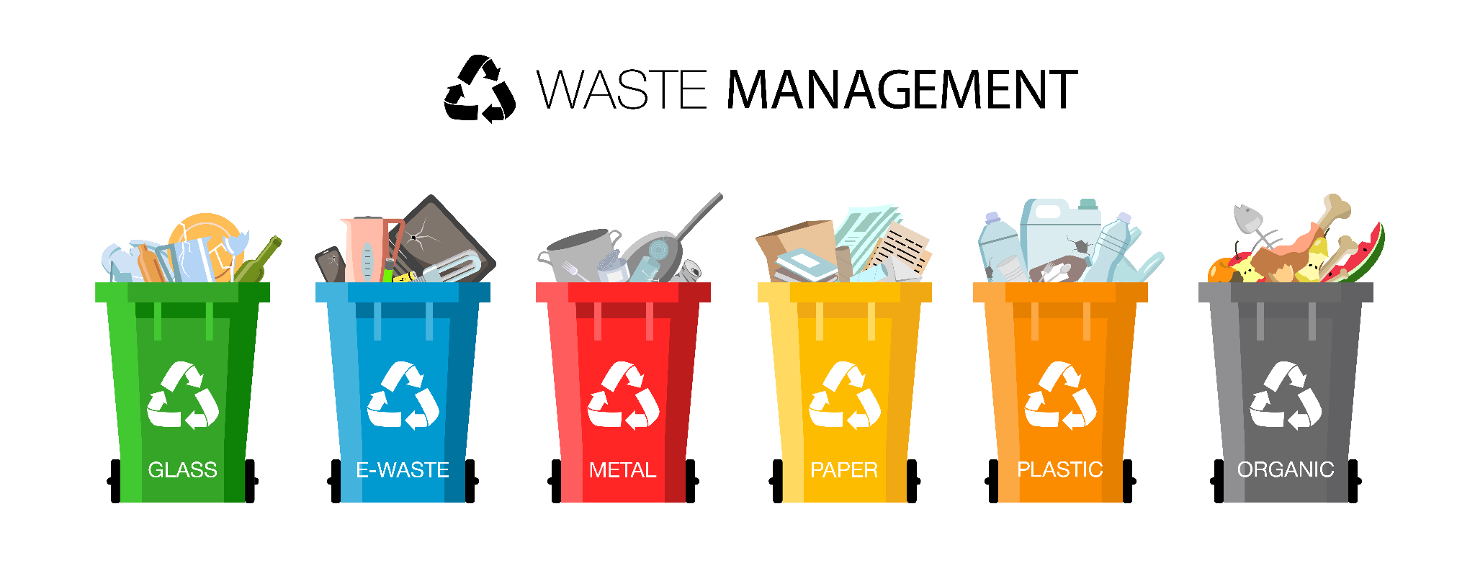
Recommendation and solution
Using sustainable energy sources rather than fossil fuels
Enhancing appropriate waste management
Increasing recycling process
Notes:
In order to reduce the rate of global warming process, there are several steps that can be taken. Among them, using sustainable energy sources such as solar power, hydro power and wind power are the most significant ones. These sources can generate power which do not harm the climate. On the other hand, increasing the plantation of trees may help to reduce global warming as a long-term planning. Proper waste management is a process that also helps to control the waste that can be generated in daily life. In this case, the three significant aspects, reduce the usage of virgin products, reusing a product as long as it can be supported and recycling them after their life-cycle ends can make a difference in the context of global warming.

Slide 21
References
Amankwah-Amoah, J., 2020. Stepping up and stepping out of COVID-19: New challenges for environmental sustainability policies in the global airline industry. Journal of Cleaner Production, 271, p.123000.
Asante, F., Guodaar, L. and Arimiyaw, S., 2021. Climate change and variability awareness and livelihood adaptive strategies among smallholder farmers in semi-arid northern Ghana. Environmental Development, 39, p.100629.
Belotto, M.J., 2018. Data analysis methods for qualitative research: Managing the challenges of coding, interrater reliability, and thematic analysis. The Qualitative Report, 23(11), pp.2622-2633.
Bran, F., Rădulescu, C.V., Bodislav, D.A. and Burlacu, S., 2020. Environmental risks in the context of globalization. Economic Convergence in European Union, 350, pp.228-235.
Castleberry, A. and Nolen, A., 2018. Thematic analysis of qualitative research data: Is it as easy as it sounds?.Currents in pharmacy teaching and learning, 10(6), pp.807-815.
epa.gov (2022) EPA. Environmental Protection Agency. Available at: https://www.epa.gov/ghgemissions/sources-greenhouse-gas-emissions (Accessed: April 11, 2023).
Evans, G.W., 2019. Projected behavioral impacts of global climate change. Annual review of psychology, 70, pp.449-474.
Hunter, D., McCallum, J. and Howes, D., 2019. Defining exploratory-descriptive qualitative (EDQ) research and considering its application to healthcare. Journal of Nursing and Health Care, 4(1).
Pandey, J., 2019. Deductive approach to content analysis. In Qualitative techniques for workplace data analysis (pp. 145-169). IGI Global.
Pearse, N., 2019, June. An illustration of deductive analysis in qualitative research. In 18th European conference on research methodology for business and management studies (p. 264).
un.org (2022) un.org. Available at: https://www.un.org/sustainabledevelopment/wp-content/uploads/2016/08/5_Why-It-Matters-2020.pdf (Accessed: April 11, 2023).
un.org (2023) Climate change - united nations sustainable development, United Nations. United Nations. Available at: https://www.un.org/sustainabledevelopment/climate-change/ (Accessed: April 11, 2023).
who.int (2023) Climate change, World Health Organization. World Health Organization. Available at: https://www.who.int/health-topics/climate-change#tab=tab_1 (Accessed: April 11, 2023).

Slide 22


